Slide 1
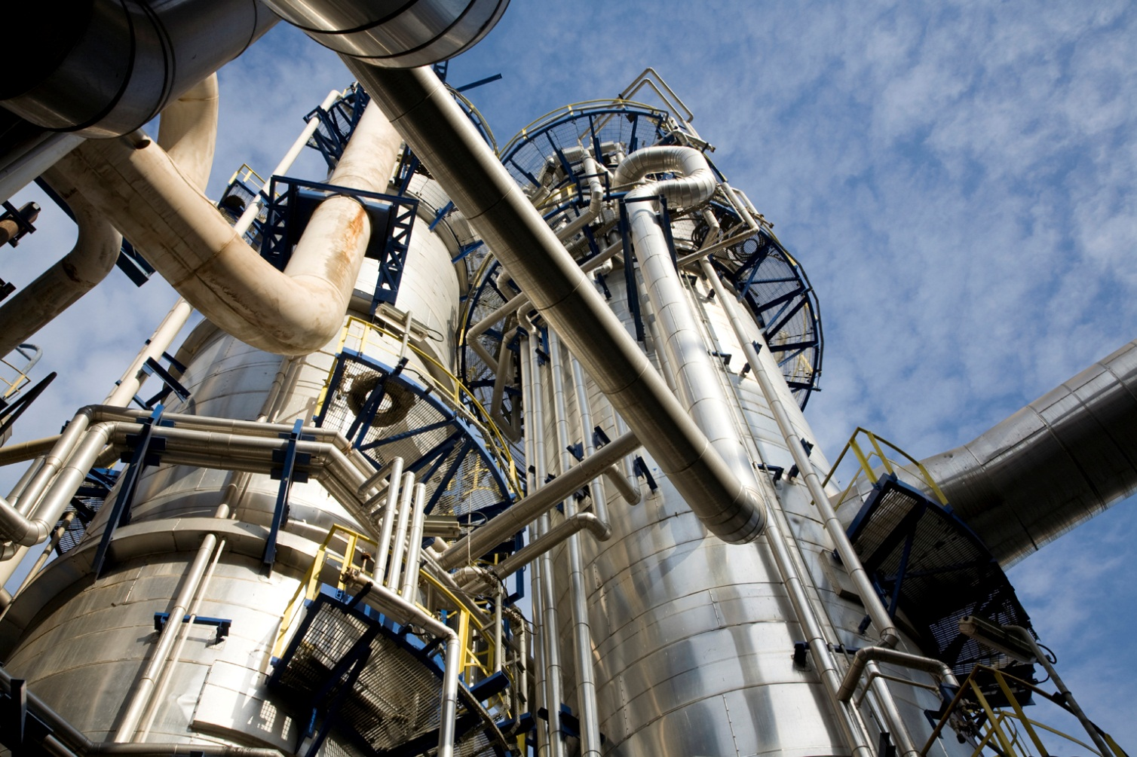
Functional Safety in industry application
Yunxi Zhang 张云禧
TÜV Rheinland Greater China
+86 10 65666660-149
Yunxi.zhang@tuv.com
www.tuvasi.com

Slide 2
Topics under discussion
1
History in Functional Safety
2
Terms of Functional Safety
3
Systematic Faults according to IEC 61508-2
4
Random Faults according to IEC 61508-2
2

Slide 3
History in Functional Safety
Functional Safety
and
TÜV Rheinland
in
the past 40 years

Slide 4
Use of electronic circuits in safety related application
Safety Consideration - Functional Safety
Beginning in the 1970‘s TÜV Rheinland carried out type approval
of safety related electronic circuits, mainly fail-safe technology
Low complex components, hard wired technology
Measures e.g.:
Failure Mode and Effect Analysis (FMEA)
Failure rate (λ), MTBF calculation

Slide 5
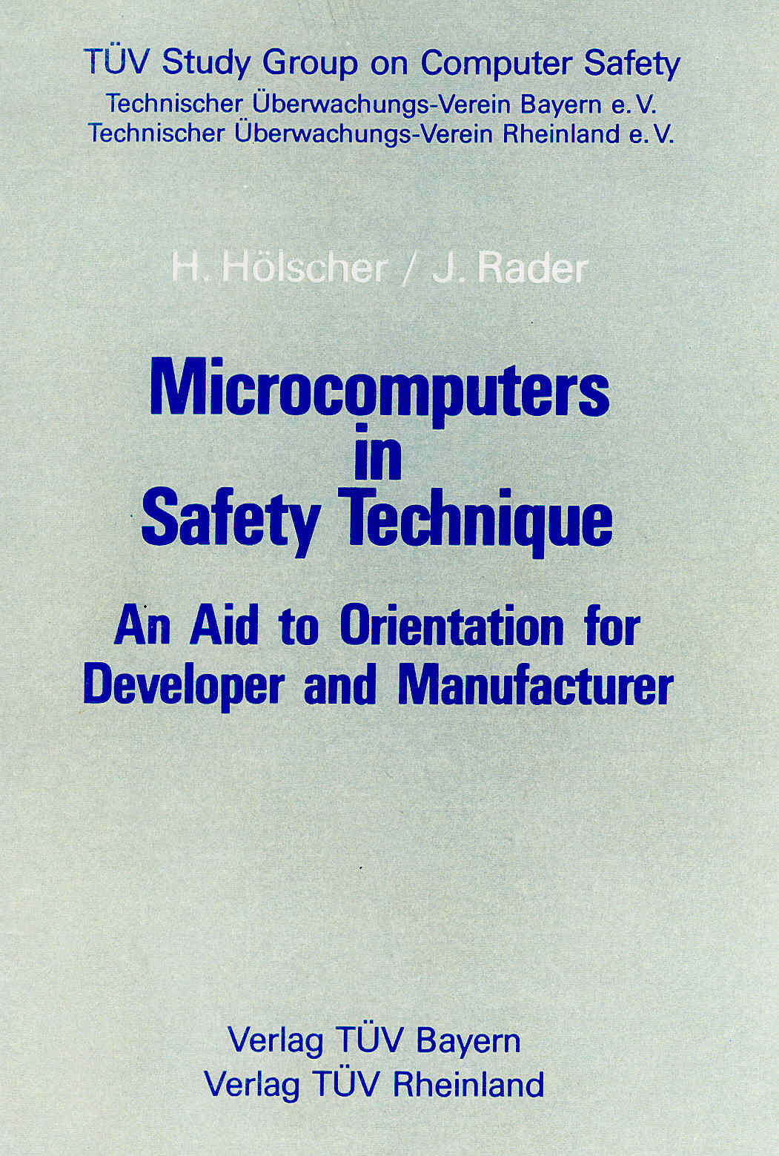
TÜV Handbook “Microcomputer in Safety Technique”
Research project computer safety
Definition of safety classes (5)
Fault models of integrated circuits
Structures, redundancy, diversity
Diagnostic measures for: CPU, RAM, ROM Communication, I/O ….
Internal discussion of: Failure rates Failure rate targets related to safety classes Diagnostic coverage not accepted in industrial standards at that time
Results published as book 1984

Slide 6
Certification of Programmable Electronic Systems
Early 1980‘s Microprocessor based Transmitter
1986 First Safety related Programmable Logic Controller (PLC)
1oo2 Architecture
1991 Programmable Logic Controller (PLC)
TMR system 2oo3
1992 Programmable Logic Controller (PLC)
TMR system 2oo3, hot stand by

Slide 7
Development of safety related standards
Security …….
1984 1989 1996 2000 2003 2006 2010 2011 20xx
TÜV handbook
EN 1050 EN 954 VDE 0801 A.1
IEC 61508
IEC 61511 EN 50156
EN ISO 13849 IEC 62061
IEC 61508 Ed. 2
ISO 26262
IEC xxxx
DIN 19250 VDE 0801 VDE 0116
and many other product or
application standards
Safety classes
Requirement classes / Safety Category
Safety Integrity Level / Performance Level

Slide 8
Functional Safety Standards used for Certification
Security …….
1984 1989 1996 2000 2003 2005 2010 2015
Application related Standards and TÜV handbook
IEC 61508, EN ISO 13849, EN 50156,
IEC 61511 and other Application Standards
IEC 61508, ISO 26262 and other product or
Application standards
DIN 19250, VDE 0801 VDE 0116 and other
Application related Standards

Slide 9
Relation of IEC 61508 / Sector, Application Standards
Overview:
ISO 13849-1
Machinery
IEC 61800-5-2
Electrical drives
IEC 61513
Nuclear Sector
IEC 61508
EN 50128
Railway
application
IEC 62061
Machinery
IEC 60601
Medical devices
EN 81
Lifts
IEC 61511
Process Sector
EN 50156
Furnaces

Slide 10
Terms of Functional Safety

Slide 11
„Functional Safety“
A safety system is functionally safe if
Random,
systematic and
common cause
failures do not lead to malfunctioning of the safety system and do not result in
injury or death of humans
pollution of the environment
loss of equipment or production
The safety function of a device / control system has to be guaranteed both under normal conditions and in the existence of faults.
37
11
Notes:
4
4
Kr - Gb_Basis 61508- Begriffe der Sicherheitstechnik.pptm
37

Slide 12
„Safety Function“
IEC 61508-4, 3.5.1
A function of a safety related system to reduce the risk in an
application with the objective to achieve or keep a safe state.
The safety function is always related to a safety loop, not to a component or device.
Sensor
Logic
Actuator
U
PLC
41
12
Notes:
4
4
Kr - Gb_Basis 61508- Begriffe der Sicherheitstechnik.pptm
41

Slide 13
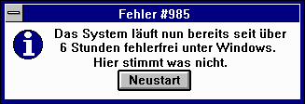
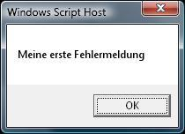
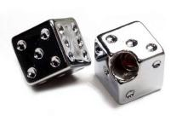
„Systematic and random faults“
IEC 61508-4 3.6.5-6
Systematic faults
Software Bugs
Pentium FDIV-Bug
…
Fault
The system is already operating in Windows error-free for over 6 hours. Something must be wrong here.
Restart
My first fault message
My first fault message!
Random faults
Ageing or worsening of components
Soft Errors
…
44
13
Notes:
4
4
Kr - Gb_Basis 61508- Begriffe der Sicherheitstechnik.pptm
44

Slide 14
Target failure measures
IEC 61508-1 , Table 2 / Table 3
target failure measures for a safety function operating in low demand mode
of operation
PFD_{AV}
2. target failure measures for a safety function operating in high demand or continuous mode of operation
PFH
86
114
Notes:
7
7
Kr - Gb_Basis 61508- Risikoanalyse.pptm
86

Slide 15
Safety Function, Safety Loop
Sensor
E / E / PES
Actuator
35%
15%
50%
Typical share of failure rates experienced by industrial plants
233
15
Notes:
20
20
Stf - Gb_IEC61508-2 Sicherheitstechnische Parameter PFD-PFH.pptm
233

Slide 16
Systematic Faults according to IEC 61508-2

Slide 17
Type of Faults
Fault: abnormal condition, that may cause loss resp. at least a reduction of a functional unit (system or sub-system) to perform a required function
Failure with definite cause, can only be eliminated by alteration of design, production process, operating mode, operation instructions or other influencing factors
Failure / fault
Systematic failure
Random failure
Failure, occurring at a random time and whose cause can not be defined distinctively
Fault control
Fault avoidance/
Fault control
148
16
Notes:
13
13
Stf - Gb_IEC61508-2 Systematische Fehler.pptm
148

Slide 18
Measures to avoid systematic faults (QM)
Annex B of IEC 61508-2:
Recommendation of measures and methods to avoid systematic faults in hardware during the different life cycle phases
Annex B and C of IEC 61508-7:
Description of measures and methods with further references
149
17
Notes:
13
13
Stf - Gb_IEC61508-2 Systematische Fehler.pptm
149

Slide 19
Measures to control systematic failures
IEC 61508-2 , Annex A.3
The standard requires the application of QM measures to avoid failures in the different phases during the life cycle of a product. The requirement to apply these measures is dependent on the SIL. No matter how well these measures are applied, there is a residual probability of systematic failures occurring.
That's why the standard requires the implementation of measures and techniques to control systematic failures
caused by HW and SW design (see IEC 61508-2, Table A.15)
due to environmental stress or external influences (incl. EMC) (see IEC 61508-2, Table A.16)
during operation, (operator mistakes) (see IEC 61508-2, Table A.17)
156
18
Notes:
13
13
Stf - Gb_IEC61508-2 Systematische Fehler.pptm
156

Slide 20
Random Faults according to IEC 61508-2

Slide 21
Type of Faults
Fault: abnormal condition, that may cause loss; at least a reduction of a functional unit (system or sub-system) to perform a required function
Failure with definite cause, can only be eliminated by alteration of design, production process, operating mode, operation instructions or other influencing factors
Failure / fault
Systematic failure
Random failure
Failure, occurring at a random time and whose cause can not be defined distinctively
Fault control
Fault avoidance/
Fault control
172
20
Notes:
15
15
Stf - Gb_IEC61508-2 zufällige Fehler und Ausfallbetrachtungen.pptm
172

Slide 22
Measures to control random faults (on-line diagnostic)
Annex A Table A.2 ….. Table A.14 of IEC 61508-2:
Techniques/measures to control random faults of different component
Annex B and C of IEC 61508-7:
Description of measures and methods with further references
149
21
Notes:
13
13
Stf - Gb_IEC61508-2 Systematische Fehler.pptm
149

Slide 23
Thank you !
Any question please feel free to contact:
肖潇然
jane.xiao@tuv.com
+86 10 6566 6660-174
13811276916

